Slide 1

Project Name : “WEB BASED PLACEMENT MANAGEMENT SYSTEM USING CERTIFICATE AUTHENTICATOR”
Group Members:
K Goutham Raju TC02014518
Tejas C. TC02014533
impana TC02014517
Varsha HS . TC02014535
Deepu MS TC02014512
Veena L C TC02014536
Chaitra M S TC02014508
Team Name : TNS C2TC-B45

Slide 2
Challenge Statement
he purpose of the project “WEB BASED PLACEMENT MANAGEMENT SYSTEM USING CERTIFICATE AUTHENTICATOR”, the manual work makes the process slow and other problems such as inconsistency and ambiguity on operations. In order to avoid this web-based placement managed system is proposed, where the student information in the college with regard to placement is managed efficiently. It intends to help fast in fast access procedures in placement related activities and ensures to maintain the details of the student. Students logging should be able to upload their personal and educational information. The key feature of this project is that it is one-time registration enabled. The placement cell calls the companies to select their students for jobs via the campus interview. The placement cell allows the companies to view the student resumes in selective manner. They can filter the students’ profile as per their requirement. The job details of the placed students will be provided by the administrator.

Slide 3
Road Map
Postman
Controller Layer
Service Layer
Repository Layer
Database
Application will be developed in following Sprints –

Slide 4
Plan
Design
Generate the skeleton as per class design provided
TDD approach
Identify test cases for each module
Write Failing Test cases
Convert the Test Cases in GREEN
Implement the case study in incremental manner

Slide 5
Modules
Login Module:
All university and corporate must login into the website to view student information, placement schedule information. All user names and password must be protected by using this module, which means that for each user, there must be unique username and password.
Student process module:
In this module,
University can post new student data by giving the following information,
Student name
Qualification
Course
Year of passing
Certificate
Corporate can download the certificate of a particular candidate by giving following information
Student name
Hal ticket number
Search module:
In this module corporate can search for candidate information. The search process is working based upon the search string, which is related to name or hall ticket number.
Placement schedule module:
In this module corporate can schedule a campus placement in particular university by giving the following information
Schedule date
Qualification
Year

Slide 6
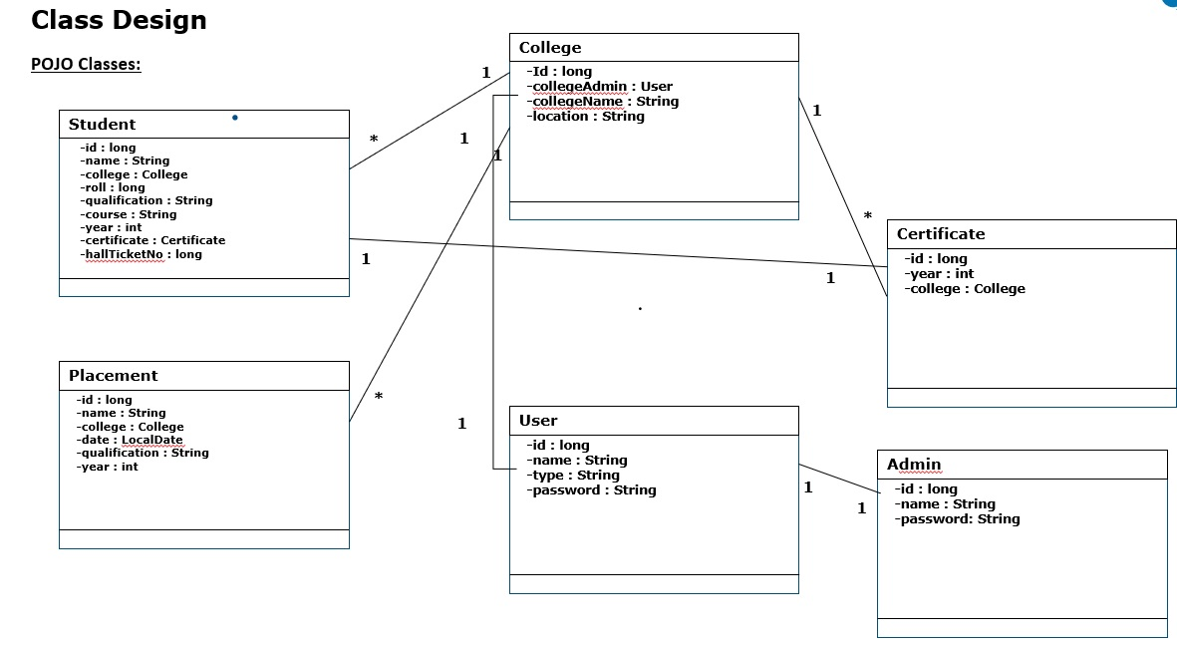

Slide 7
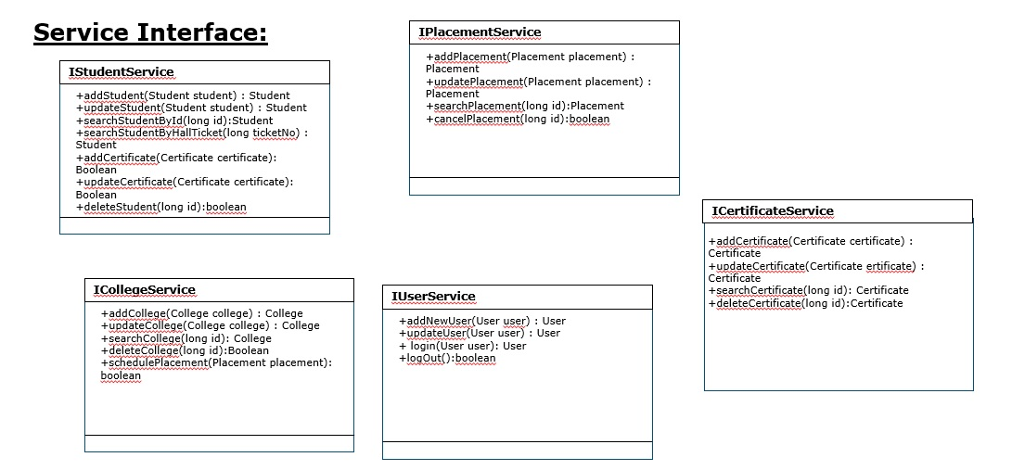

Slide 8
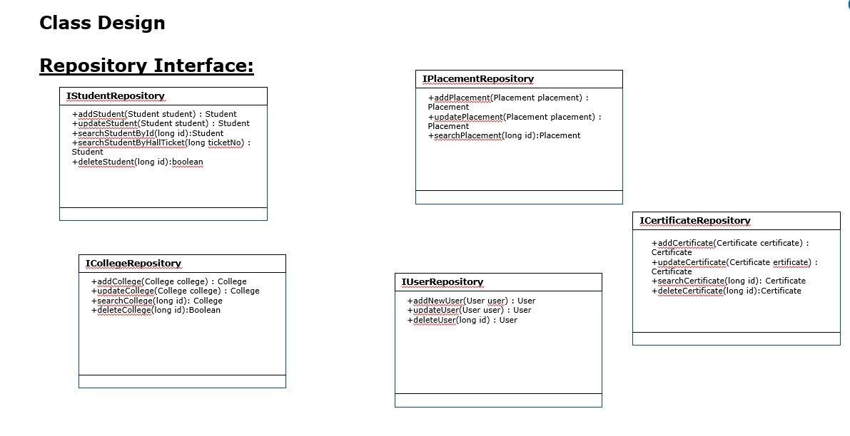

Slide 9
Thank you!

